Slide 1
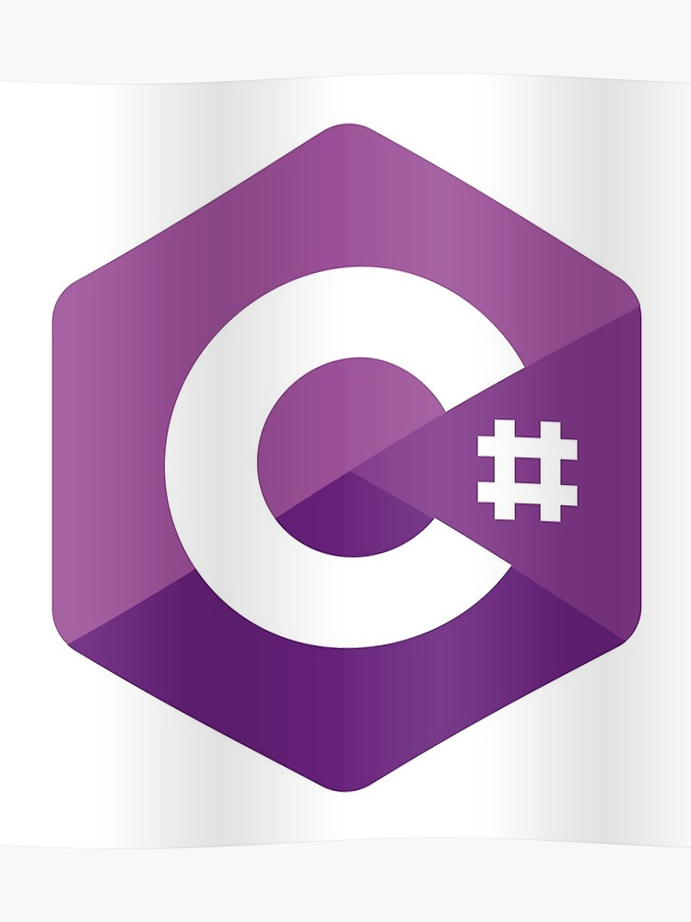
C# Coding Language
History
Why C#
C# Syntax
C# Usage

Slide 2

History of C#
C# was developed by Microsoft within its .NET framework initiative
C# programming language is a general-purpose, OOPS based programming language.
C# development team was lead by "Anders Hejlsberg" in 2002

Slide 3
Power of C#
Minimal learning curve for everybody
Much cleaner than C++
More structured than Visual Basic
More powerful than Java

Slide 4
Statements and Comments
Case Sensitive ( myVar != MyVar )
Statement delimiter is semicolon ;
Block delimiter is curly brackets { }
Single line comment is //

Slide 5
C# Statements
If Statement
Switch Statement
Do Loop
While Loop
For Loop
Foreach Statement

Slide 6
Why is C# used
C# has already been used for projects as diverse as dynamic Web sites, development tools, and even compilers. C# was created as an object-oriented programming (OOP) language. Other programming languages include object-oriented features, but very few are fully object-oriented.

Slide 7

What can C# be used for?
C# can be used to create almost anything
Particularly strong at building Windows desktop applications and games.
To develop web applications
Become increasingly popular for mobile development too.

